Slide 1


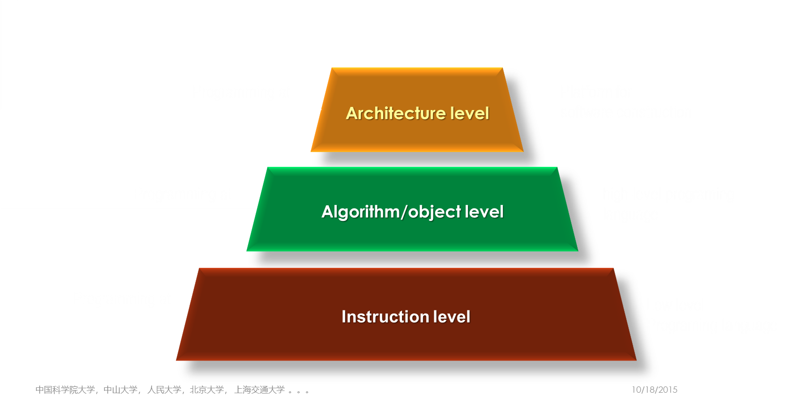
Very High-Level Programming and Low/no Code Movement Software Development with Architecturalization
Haikuan Li, Visiting Professor
CLEBA Group, Delfgauw
The Netherlands
Haikuan Li, “Software Development Paradigm in the Era of Big Data, ” Lecture Notes, CLEBA Group, Delfgauw, The Netherlands, April 2020
Notes:
The title of the course is “Software Development Paradigm in the Era of Big Data”.

Slide 2
Very High-Level Programming 超高级程序设计
The progress from early low-level programming to today's high-level programming, made a great improvement in the efficiency and quality of software development; and the progress from high-level programming to very high-level programming will greatly improve the software development further.
从早年的低级程序设计到​​今天的高级程序设计的进步，软件开发的效率与质量得到大幅度的提高；而从高级程序设计到​​超高级程序设计的进步将大幅度地提高了软件开发的效率和质量。

Slide 3
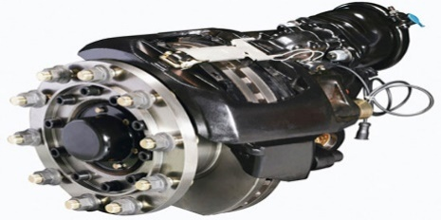
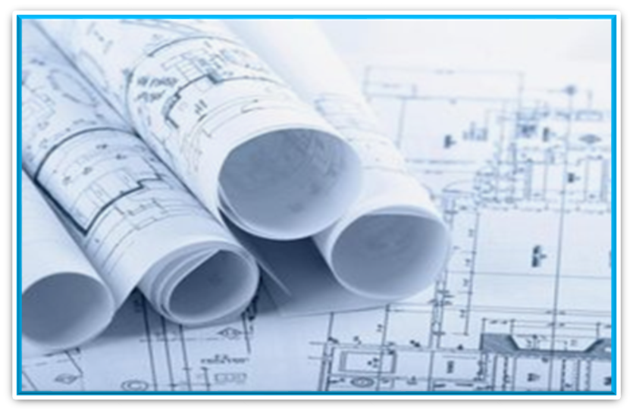
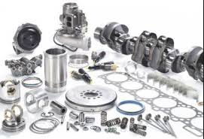
Define Software System 定义软件系统
=
+
<Machine> ::= Assembly Drawing + Machine Parts
<System> ::= Architecture + Components
A system is a collection of components organized to accomplish a specific function or set of functions. [IEEE 1471]
A component is a unit of composition with contractually specified interfaces and explicit context dependencies only [WCOOP’96].
An architecture refers to the organizational structure of a system.

Slide 5
Software Components
1960s
Subroutines
1970s
Modules
1980s
Objects
1990s
Components
2000S
Services
2010s
SDTS
Static Components
Active Components

Slide 6
Evolution of Programming and Integration
Sequence of Instructions = Program
ABSTRACTION
Algorithms + Data Structures = Programs - [N. Wirth 1976]
Algorithm Structures + Abstract Data types = Programs - [H. Li, 1993]
Architecture + Components = System - [H. Li, 2009]
Service-Oriented Architecture + Services = System - [H. Li, 2012]

Slide 7
The Progress in Software Development
Programming at
Architecture level
Low Code Platforms or Software Product Lines
Algorithm/object level
Programming at
high-level programing language
Instruction level
Programming at
Low level Programing language

Slide 8
Features of Very high-level Programming
Architecture centered and high-level abstraction
System components may be active in advance.
A combination of hard ware and software in the status of service or
Consists of active components or software defined things including even living things like men and animals or
A cyber physical system (CPS) that integrates sensing, computation, control and networking into physical objects and infrastructure, connecting them to the Internet and to each other.
The architecture is considered as a network style one, while
the components are likely software defined things apearing in internet,.

Slide 9
Programming Languages
1GL Machine Code
2GL Assembly Language (Assembler):a more readable machine code
3GL Procedural Language Pascal, C++, Ada, Java,
4GL Non-Procedural Language SQL, Mapper
5GL Prolog、OPS5, Mercury
Other Generation-based Language Oracle Designer, Report Generator, Jimes Martin Diagram generator,

Slide 10
Very high-level Programming (Examples)
Dynamic Programming:
Service-Oriented Programming:
System Discovery:
Low-Code Platforms
Software Product Lines
System = Network Style Architecture + Active Components
System = Service-Oriented Architecture + Services
System = Relation-Oriented Architecture + Active Components
Application Assembling + Application Generators
Software Development with Strategic Reuse

Slide 11
Dynamic Programming
System = Network-Style Architecture + Active Components
Network Style Architecture
Software Defined Things
System Integration
Cluster Style System Architecture

Slide 12
Service-oriented Programming (SOP)
System = System Architecture + Active Components.
SOP is a programming paradigm that uses “services” as components, to design and implement integrated business applications.
Business driven: services can represent steps of business processes, leading to the cost-effective delivery of standalone or composite business applications that can “integrate from the inside-out”
Notes:
Service-oriented architecture (SOA) is an architectural style that supports service orientation.[1] over a network.
A service is a discrete unit of functionality that can be accessed remotely and acted upon and updated independently[2],
In service-oriented architecture, the functionalities may be provided between the application components through a communication protocol over a network [2].
[1] "SOA Source Book - What Is SOA?". collaboration.opengroup.org. Retrieved March 30, 2021.
[2] "Chapter 1: Service Oriented Architecture (SOA)". msdn.microsoft.com. Archived from the original on July 7, 2017.

Slide 13
System Discovery
System = Relation-Oriented Architecture + Active Components
Domain Definition: Define a set of things and relations between them.
Service Discovery: Identify the software defined things from Internet, e.g. Business Process, Supply Chain, User Group, etc.
Machine Learning: Relation-Oriented Clustering
If necessary, providing additional management, control and services
System Discovery

Slide 14
Cluster Style System Development
Active Components: A System consists of a set of active components that are services or any software defined things in internet, such as web services, mobile, PC, taxi, doctor etc.
Cluster : A cluster consists of a set of active components and the interconnection between them, forming a piece of network. The connections between the components inside a cluster are high coherent and the connection between clusters are loosely coupled.
Network Style Architecture: A system consists of a set of clusters that are implemented via the interconnection between the components of different clusters.

Slide 15
Low-Code Development Platforms (LCDP)
Organizations are increasingly turning to low-code application platforms to modernize legacy processes and quickly deliver new, digital customer experiences. --Gartner’s report
LCDP provides a development environment used to create application software through a graphical user interface. A low-coded platform may produce entirely operational applications, or require additional coding for specific situations.
LCDP is software engineering methods, tools and techniques for creating a collection of similar software systems from a shared set of software assets using a common means of production
Example, Google App Engine is a cloud computing platform as a service for developing and hosting web applications in Google-managed data centers.
Technology：Graphical User Interface, Application Generator, Software Reuse.
Refer：Richardson, Clay (June 9, 2014). "New Development Platforms Emerge For Customer-Facing Applications". www.forrester.com. Retrieved 18 November 2016.

Slide 16
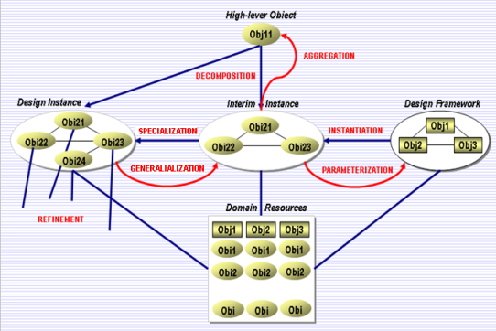
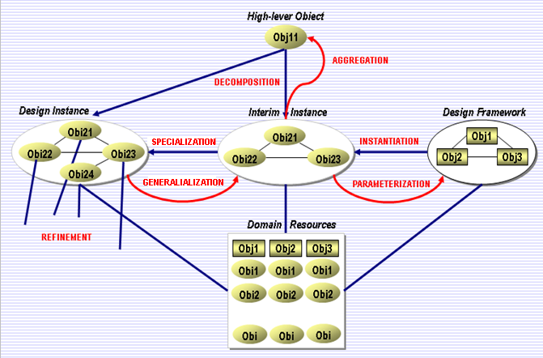

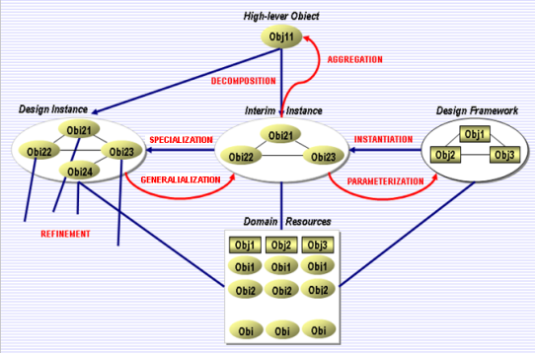
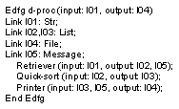
Existing Systems
New
Systems
Domain
Resources
Life Cycle Based Engineering
Software Data Mining
Reusable
Artifacts
Reusable
Artifacts
Web services
Software Data Mining
Organization Model
Operational Model
Reusable Artifacts
Reusable Artifacts
Reusable Artifacts
Reusable Artifacts
User Interface
Software mining
Legacy Systems
Legacy Systems

Slide 17

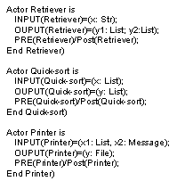
An Example of LSC Specification Data Processor – the actor at top-level
The organizational structures of the entities to form a design
Cover a set of entities for the instantiation of the design frame work
Design instance: made by Instantiating the design framework with Domain Entity and necessary specialization
Actor d-proc
-- Producer : Retriever
-- Sorter : Quick-sort
-- Deliverer : printer
Design with Reuse
Design instance =
Design framework +
Domain Entity +
Additional features
The terminal component implemented or to be implemented.

Slide 18
Very high-level Programming Language
VHLL is a programming language with a very high-level of abstraction, used primarily as a professional programmer productivity tool.[wiki]
VHLL is designed to reduce the complexity and amount of source code required to create a program.
VHLL incorporates higher data and control abstraction abilities， is also known as a goal-oriented programming language. [Techopedia]

Slide 19

Q&A
Programming at
Architecture level
Platform for
software construction
Algorithm/object level
Programming at
high-level programing language
Instruction level
Programming at
Low level Programing language

Slide 20
Q&A：Very High-Level Programming
What is the difference between the definitions of “system” given by teacher and that of IEEE?
What is the role that the architecture plays in software construction?
What is very high-level programing?
What is the difference between high-level and very high-level programming?
Do you think that the high-level programming will be outdated ?
What are the advantages of very high-level programming?
What mean by system discovery?
Translate the following phrases into Chinese.
An architect in the field of building and an architect in software engineering
The dynamic programing in mathematics and the dynamic programing in software engineering

Slide 21
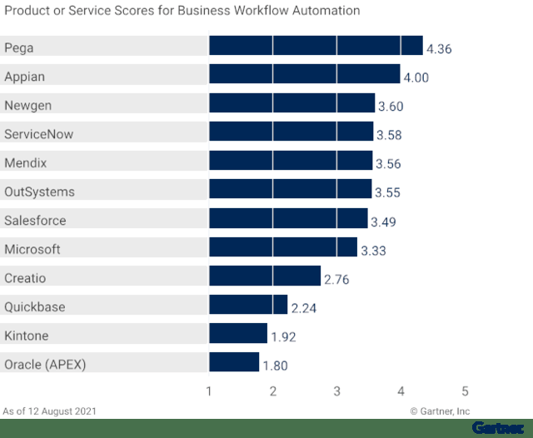
Low-Code Development Platforms
Organizations are increasingly turning to low-code application platforms to modernize legacy processes and quickly deliver new, digital customer experiences. --Gartner’s report

